Slide 1
Task 1

Slide 2
Task description
Given a hierarchically structured color palette, classify the contained colors such that a palette is searchable using categorical names.
user searches "azurblau" (=color region), then result are all hierarchical color palettes which contain that color in them, user defines the level of hierarchy for color palette (better to have lower levels than higher levels) or user defines threshold &gt; at the %color pixel from total color palette, x-axis (breite vom patch) is the number of pixels Ïindner: colorthesaurus Ï'duser searches out of 6 basic colors (12 colors etc.. until all categorical names), then result are all hierarchical color palettes with that color in them

Slide 3
funktion: listen von farben eingeben wie z.B. 6, und lab raum anhand von diesen 6 farben segmentiert (hyperplanes) (irgendeine farbe)

Slide 4
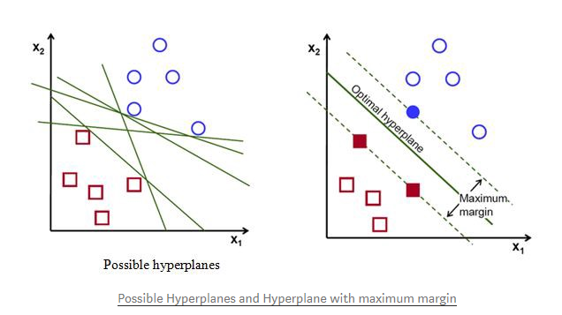
Operationalization
ML: clustering task
Methods: support vector machine (scikit-learn module)
Objective function = draw the contour which will maximize the inter-class distance, find a plane that has the maximum margin i.e. the maximum distance between data points of both classes
Decision Boundary: linear (vs. non-linear)

Slide 5
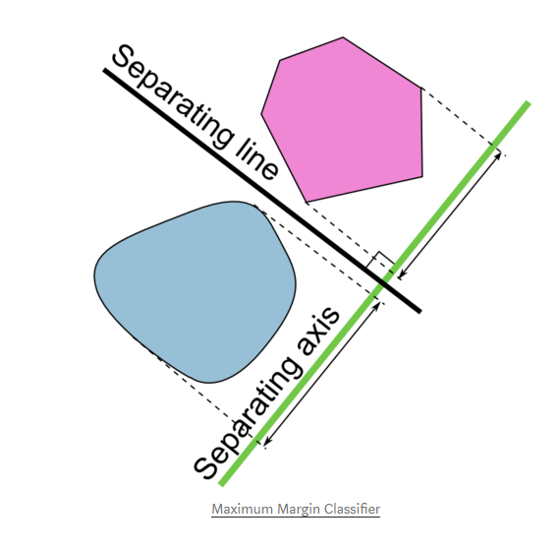
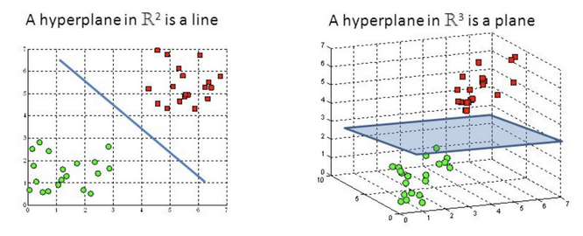
https://towardsdatascience.com/a-friendly-introduction-to-support-vector-machines-svm-925b68c5a079

Slide 6
Query
I have an unordered set of two dimensional points, being the result of a image segmentation. The points when drawn together in a bitmap are a contigous region.
I'd like to know which points are in it's (region) border.
Classification problems need decision boundary
The Decision Boundary separates the data-points into regions, which are actually the classes in which they belong.
visualize the classification of the data-points in Feature Space
https://towardsdatascience.com/decision-boundary-visualization-a-z-6a63ae9cca7d

Slide 7
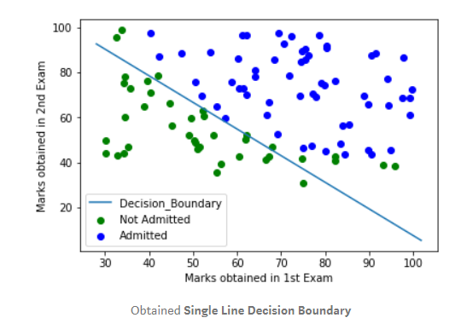
Decision Boundary
Single-line decision boundary
Contour-based decision boundary

